Slide 1

Exploratory Data Analysis on AMEO Dataset
- Dinesh Nakkina

Slide 2
About me
As someone with a Master's degree in Statistics, I'm passionate about using data to solve problems. I love digging into big piles of information to find useful insights that can help businesses make smart decisions and come up with new ideas.
I enjoy working with teams and chatting with people from different backgrounds. I'm pretty good at learning new stuff quickly, and I don't get too stressed out when things get busy.
I'm excited about Data Science because it lets me use my stats skills to uncover interesting things in data. It's like solving puzzles with numbers, and it can really make a difference for companies and society.
I'm looking forward to jumping into the world of Data Science and seeing where it takes me!

Slide 3
Exploratory Data Analysis
Observations from Data:-
Salary:
The average salary is approximately 307,699 with a standard deviation of 212,737.
The minimum salary is 35,000, and the maximum salary is 4,000,000.
There is a wide range in salaries, indicating significant variability in compensation levels.
Education:
The average 10th-grade percentage is around 77.93, with a standard deviation of 9.85.
The average 12th-grade percentage is approximately 74.47, with a standard deviation of 11.00.
The average college GPA is about 71.49, with a standard deviation of 8.17.
Engineering Specializations:
There are specific columns for different engineering specializations such as Computer Science, Mechanical Engineering, Electrical Engineering, etc.
These columns contain scores or indicators related to the respective specializations.
Personality Traits:
There are columns for personality traits such as conscientiousness, agreeableness, extraversion, neuroticism, and openness to experience.
These traits are scored on a scale, with means and standard deviations indicating the average levels and variability in these traits among individuals in the dataset.

Slide 4
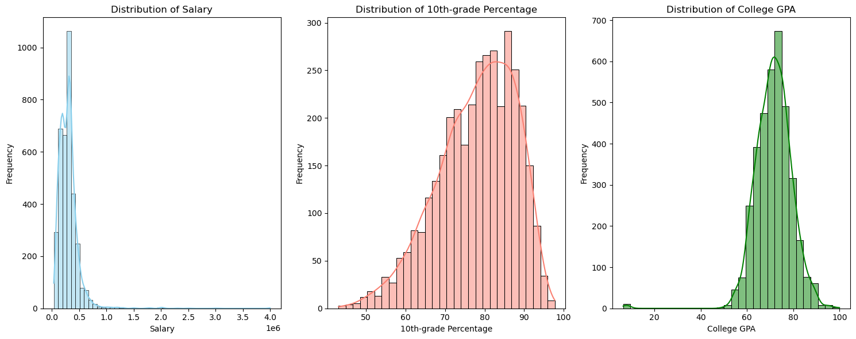
Distribution of Salary:
The majority of individuals have a salary in the lower range, indicating a skewed distribution. This could suggest income + inequality within the population.
The x-axis is labeled “Salary” ranging from 0 to 4.0e6 and y-axis labeled “Frequency” ranging from 0 to 1000.
There’s a sharp decline in frequency as salary increases, indicating fewer individuals in the higher salary ranges.
Distribution of 10th-grade Percentage:
This distribution is approximately normal, meaning most students have scores around the average, with fewer students at the extremes.
The x-axis ranges from 50 to 100 labeled “10th-grade Percentage”, and y-axis ranges from 0 to about 300 labeled “Frequency”.
Most frequencies are clustered around the middle values (70-80), suggesting that the majority of students score within this range.
Distribution of College GPA:
This distribution is also approximately normal but slightly skewed towards higher GPAs, indicating that more students have above-average GPAs.
Labeled “College GPA” on x-axis ranging from about 20 to 100 and “Frequency” on y-axis ranging up to about 700.
The skewness towards higher GPAs could suggest a grading system that allows for high achievement or a selection bias
towards students who perform well acadimically.

Slide 5
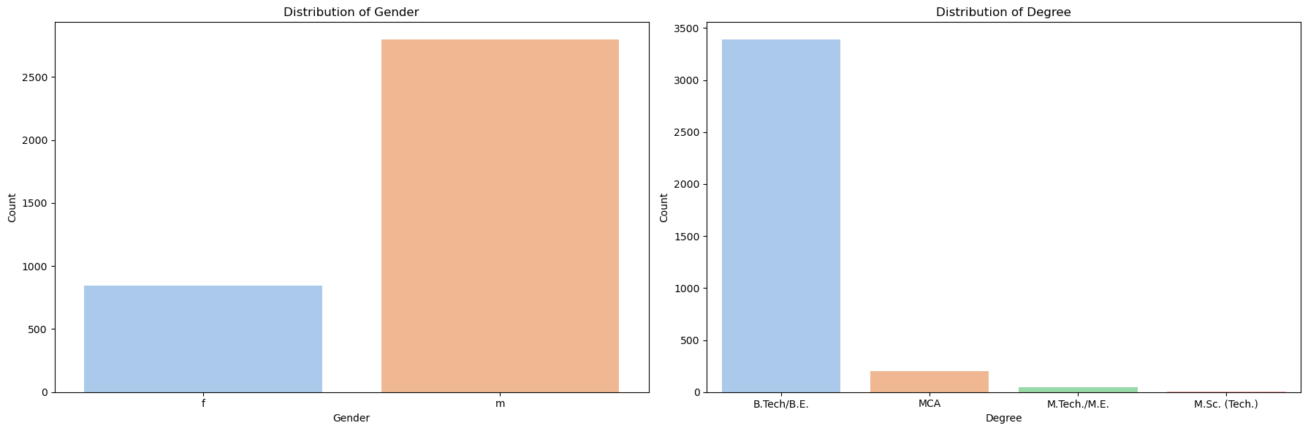
Gender Distribution:
The first plot represents the distribution of gender within the dataset. The significantly higher frequency of males (‘m’) compared to females (‘f’) suggests a male-dominated dataset. This could reflect the gender demographics of the specific field or industry from which this data was collected. It’s important to consider this gender imbalance when drawing conclusions from the data, as it may introduce bias.
Degree Distribution:
The second plot provides insights into the educational qualifications of the individuals in the dataset. The overwhelming majority of individuals hold a ‘B.Tech/B.E.’ degree. This could indicate that the dataset is heavily skewed towards individuals in engineering fields. The relatively smaller number of ‘MCA’ degree holders might suggest a lesser representation of individuals from computer applications backgrounds. The negligible counts for ‘M.Tech/M.E.’ and ‘M.Sc. (Tech.)’ degrees could indicate a very limited presence of individuals with these qualifications.

Slide 6
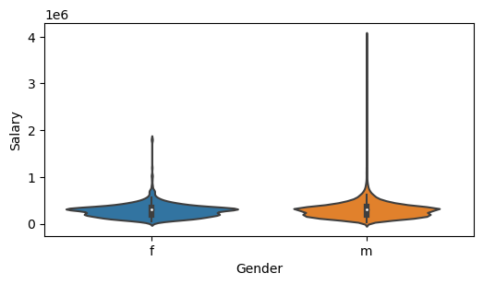
Salary Distribution: Both distributions have a wide base, indicating a higher density of individuals with lower salaries, and taper off sharply, showing fewer individuals with higher salaries. This suggests that in both categories, the majority of individuals are in the lower salary range.
Median Salary: The white dots inside the violins indicate the median salary for each category. There appears to be a difference in the median salary between the two categories, with one category having a higher median salary than the other.
Interquartile Range: The black lines inside the violins represent the interquartile range, which is the range within which the middle 50% of salaries fall. This gives us an idea of the spread of salaries in each category.

Slide 7
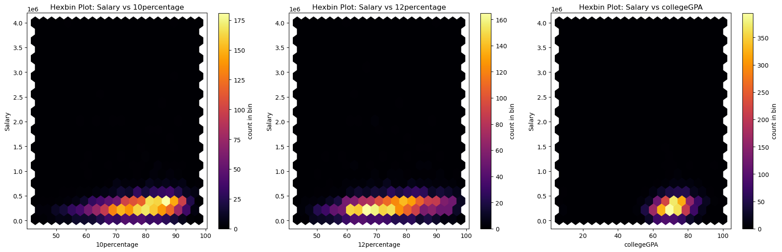
10th-grade Percentage vs Salary : The plot shows a concentration of data points at the lower salary range for various 10th-grade percentages. There is a slight inclination towards higher salaries with increased percentages, but the correlation doesn’t appear to be strong.
12th-grade Percentage vs Salary : Similar to the 10th-grade percentage, the 12th-grade percentage also shows a weak correlation with salary. Most data points are concentrated at the lower end of the salary scale.
College GPA vs Salary: The plot shows a similar pattern to the previous two. While there’s a slight increase in salary with a higher GPA, the correlation isn’t significantly pronounced.
In conclusion, while there might be some correlation between these academic metrics (10th-grade Percentage, 12th-grade Percentage, and College GPA) and salary, it doesn’t appear to be a strong or direct correlation based on these plots. This suggests that while academic performance might have some influence on salary.

Slide 8
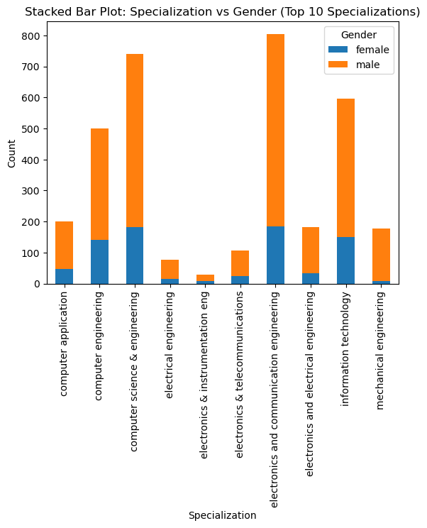
Engineering Specializations: The plot covers a range of engineering disciplines, including Computer Science, Electrical Engineering, Electronics & Telecommunication, Information Technology, and Mechanical Engineering, among others. These fields are fundamental to a wide range of industries, from technology to manufacturing.
Gender Disparity: The plot reveals a significant gender disparity in these fields. In all specializations except Computer Application and Information Technology, the number of males is significantly higher than females. This is a well-documented issue in STEM (Science, Technology, Engineering, Mathematics) fields, where women are often underrepresented.
Mechanical and Electrical & Communication Engineering: The disparity is particularly noticeable in Mechanical Engineering and Electrical & Communication Engineering. These fields have traditionally been male-dominated, and the plot suggests that this trend continues in the dataset.
Implications: This gender imbalance has important implications. Diverse teams can drive innovation and improve problem-solving, so efforts to attract and retain more women in these fields could benefit the industry. Additionally, understanding this disparity is crucial for policymakers and educators who are working to promote gender equality in STEM.

Slide 9
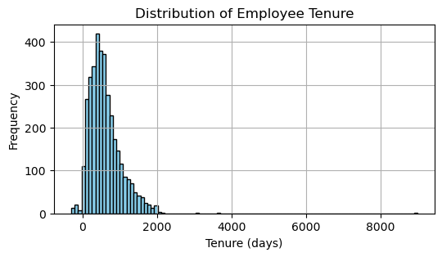
Tenure Distribution: Most bars are concentrated towards the left side, indicating that many employees have shorter tenures. As the tenure increases, the frequency of such tenures decreases sharply. This suggests that the majority of employees have a tenure of less than 2000 days.
Here are some suggestions to address this:
Employee Retention Strategies Implement strategies to improve employee retention, such as providing competitive compensation and benefits, opportunities for career advancement, a positive work environment, and work-life balance.
Exit Interviews Conduct exit interviews to understand why employees are leaving. This can provide valuable insights into areas for improvement.
Employee Engagement: Regularly engage with employees through surveys or meetings to understand their job satisfaction and address any issues promptly.

Slide 10
Research Questions
Times of India article dated Jan 18, 2019 states that “After doing your Computer Science Engineering if you take up jobs as a Programming Analyst, Software Engineer, Hardware Engineer and Associate Engineer you can earn up to 2.5-3 lakhs as a fresh graduate.
Based on the hypothesis test result and the claim, it can be concluded that individuals with a degree in Computer Science Engineering, particularly those working in roles such as Programming Analysts, Software Engineers, Hardware Engineers, or Associate Engineers, have a higher starting salary compared to those with other degrees or job roles. The average salary for individuals in these roles exceeds 2.5 lakhs, which aligns with the claim made in the Times of India article.
Individuals with a degree in Computer Science Engineering and who work as Software Engineers or Web Developers have a higher starting salary compared to those with other degrees or job roles.
The output of the t-test provides evidence to support the claim. Since the p-value (0.0021) is less than the significance level (alpha = 0.05), we reject the null hypothesis. Therefore, we can conclude that there is a significant difference in starting salaries between individuals with Computer Science Engineering degrees working as Software Engineers or Web Developers and those with other degrees or job roles. This aligns with the claim that individuals with a degree in Computer Science Engineering and who work as Software Engineers or Web Developers have a higher starting salary compared to those with other degrees or job roles.

Slide 11
Data Analysis Report
Salary Distribution
The salary distribution plot revealed a significant number of individuals at the lower end of the salary spectrum, with fewer individuals at the higher end. This suggests a degree of income inequality within the population. Most of the population appears to be earning a salary in the lower range. There are fewer individuals in the higher salary ranges. The distribution appears to be right-skewed, indicating that most of the population earns less than the average salary.
2. Academic Performance vs Salary
The plots representing the relationship between Salary and academic metrics (10th-grade Percentage, 12th-grade Percentage, and College GPA) suggested a weak correlation. While there might be some correlation between these academic metrics and salary, it doesn’t appear to be a strong or direct correlation based on these plots. This suggests that while academic performance might have some influence on salary, there are likely other factors at play as well, such as work experience, skills, industry, location, etc.
3. Gender Distribution in Engineering Specializations
The plot representing the gender distribution across various engineering specializations revealed a significant gender disparity in these fields. In all specializations except Computer Application and Information Technology, the number of males is significantly higher than females. This is a well-documented issue in STEM (Science, Technology, Engineering, Mathematics) fields, where women are often underrepresented.
4. Employee Tenure
The employee tenure plot indicated a high turnover rate or a young workforce. If this is a high turnover rate, it could be a potential problem for the organization. High turnover can lead to increased hiring and training costs, and it can also impact team morale and productivity.

Slide 12
Recommendations
Based on these insights, here are some recommendations:
Salary Policies: Review salary policies to address the disparity observed in the salary distribution.
Diversity in STEM: Implement strategies to attract and retain more women in engineering fields to address the gender disparity observed.
Employee Retention Strategies Implement strategies to improve employee retention, such as providing competitive compensation and benefits, opportunities for career advancement, a positive work environment, and work-life balance.
Exit Interviews Conduct exit interviews to understand why employees are leaving. This can provide valuable insights into areas for improvement.
Employee Engagement: Regularly engage with employees through surveys or meetings to understand their job satisfaction and address any issues promptly.

Slide 13

THANK YOU

